Slide 1
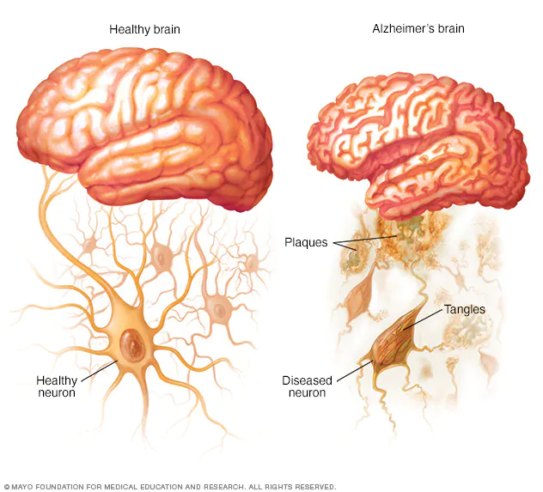
Econ 6915 Healthcare Analytics Class Project
BY: YAW DAPAA [Y00884095]
Alzheimer’s Disease
Diagnosis Prediction

Slide 2




Introduction
The aim of this project is to leverage on health data to develop a predictive model for Alzheimer’s Disease diagnosis.
This predictive model is to identify patients at risk of developing Alzheimer’s at an early stage, enabling interventions that may slow disease progression.
The insights derived could potentially provide clinicians with an evidence-based tool for diagnosing Alzheimer’s Disease earlier and more accurately.
Research Question:
How the combination of lifestyle, cognitive, and clinical factors most accurately predicts the likelihood of an Alzheimer’s Disease diagnosis?
Data:
2149 occurrences with 34 features
Data source:
Kaggle (CDC)

Slide 3
insight Statement
Alzheimer’s Disease ranks seventh among the leading causes of death in the United States and the sixth leading cause of death among adults 65 years or older. (WHO)
1 in 3 older adults die with Alzheimer’s or another dementia. The number of people living with Alzheimer's is projected to double from 6.9 million in 2020 to nearly 14 million people by 2060. (AA)
Alzheimer’s Disease not only devastates cognitive function but also places a heavy emotional and financial toll on patients and caregivers. Estimated that health and long-term care costs for people living with Alzheimer’s and other dementias are projected to reach $360 billion by the end of 2024.(AA)
Between 2000 and 2021, deaths from heart diseases have decreased 2.1% while deaths from Alzheimer’s Disease have increased 141%. Alzheimer’s disease is a type of brain disease caused by damage to nerve cells (neurons) in the brain. The brain’s neurons are essential to all human activity, including thinking, talking and walking.

Slide 4

EXPLORATORY DATA ANALYSIS

Slide 5
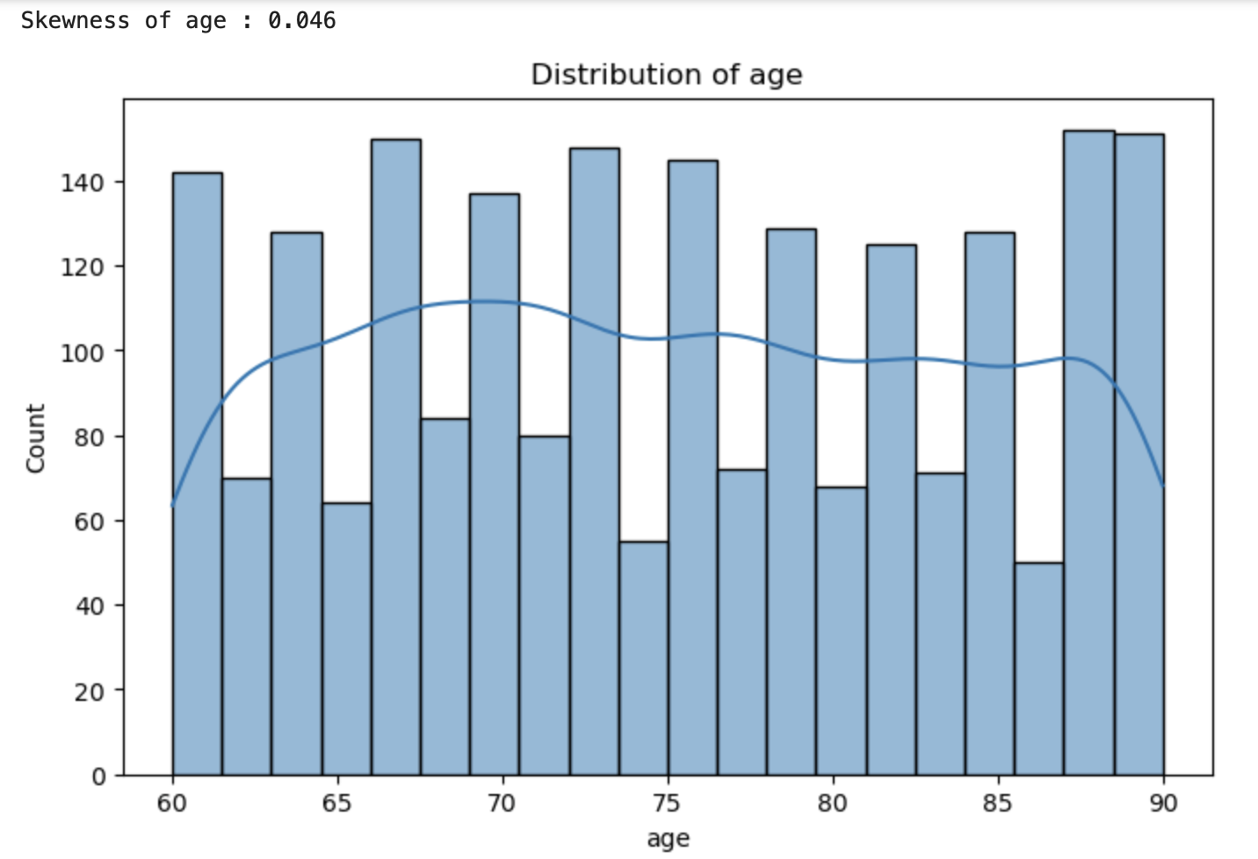
Visualization of FEATURES
Age distribution of patients ranges from 60 years to 90 years,
since this age group represents people who are highly likely
to be diagnosed with Alzheimer’s disease
Both females and males are equally
represented across the dataset.
Notes:
NOTE: The use of 'male' and 'female' as gender categories is solely based on the available data and not intended to imply any bias. The dataset may lack representation of non-binary or other gender identities. We acknowledge this limitation in our data collection.

Slide 6
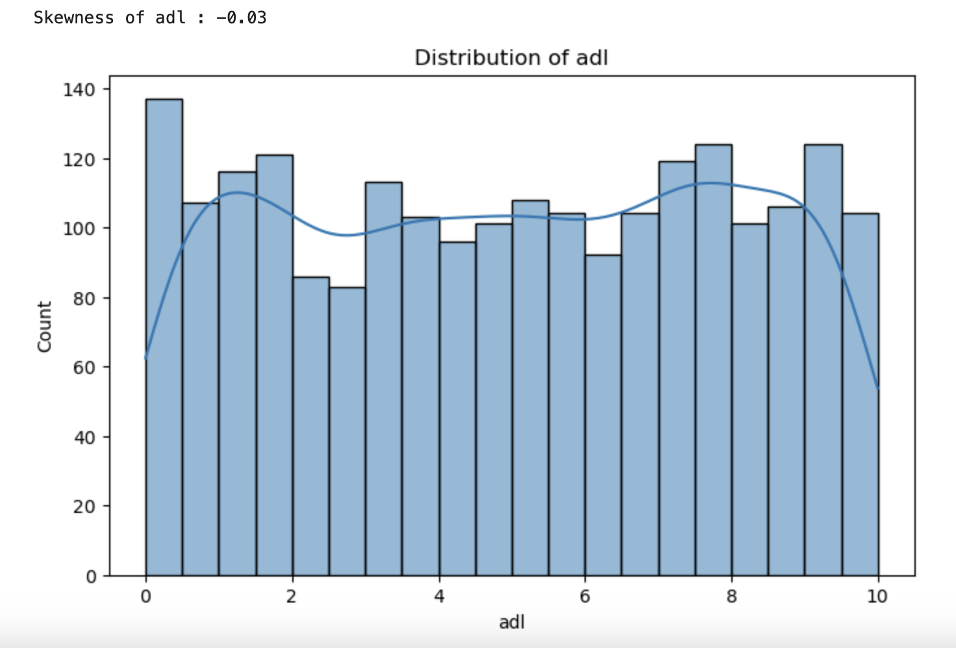
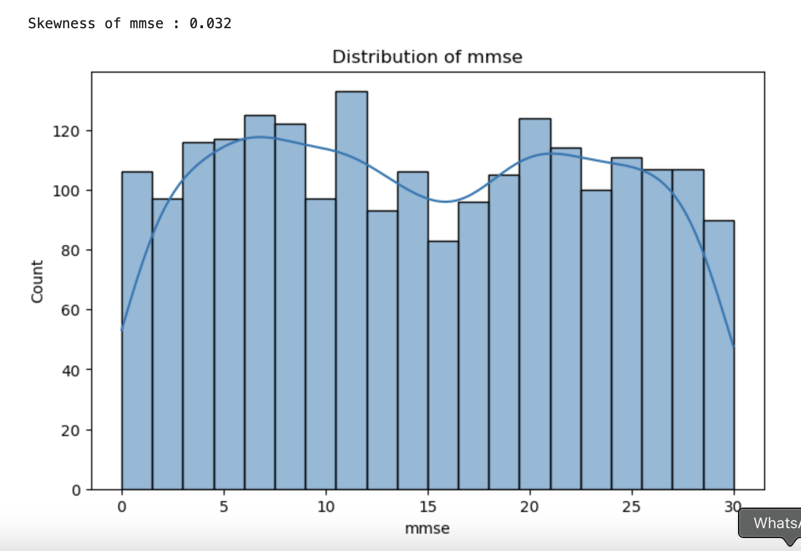
EXPLORATORY DATA ANALYSIS cont’d

Slide 7
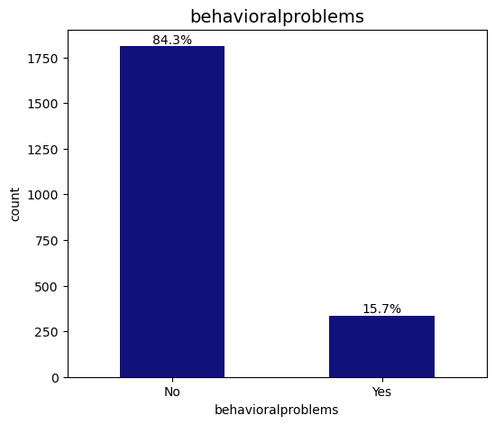
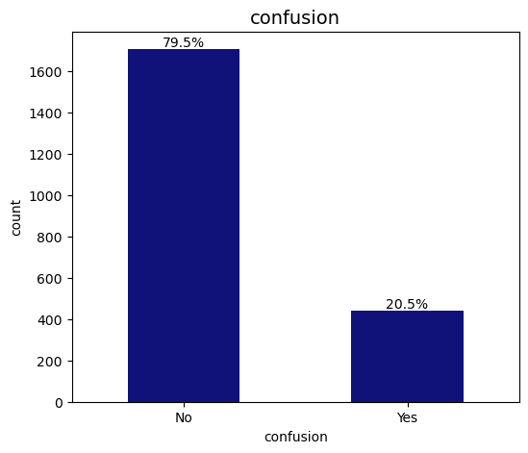
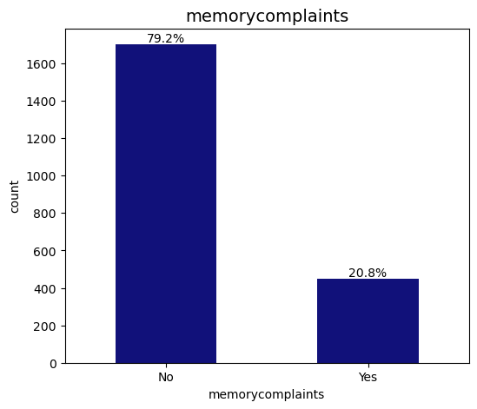

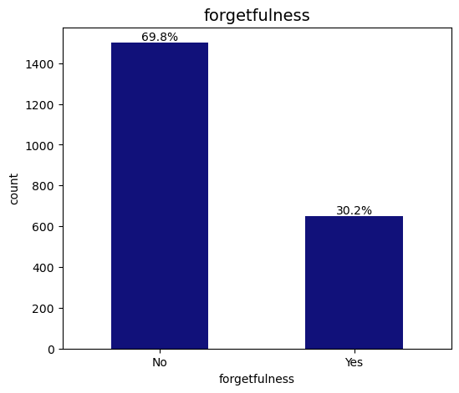
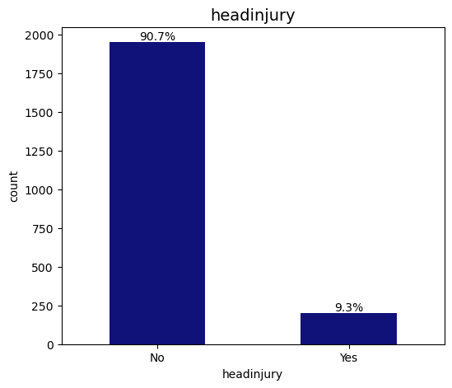

Slide 8
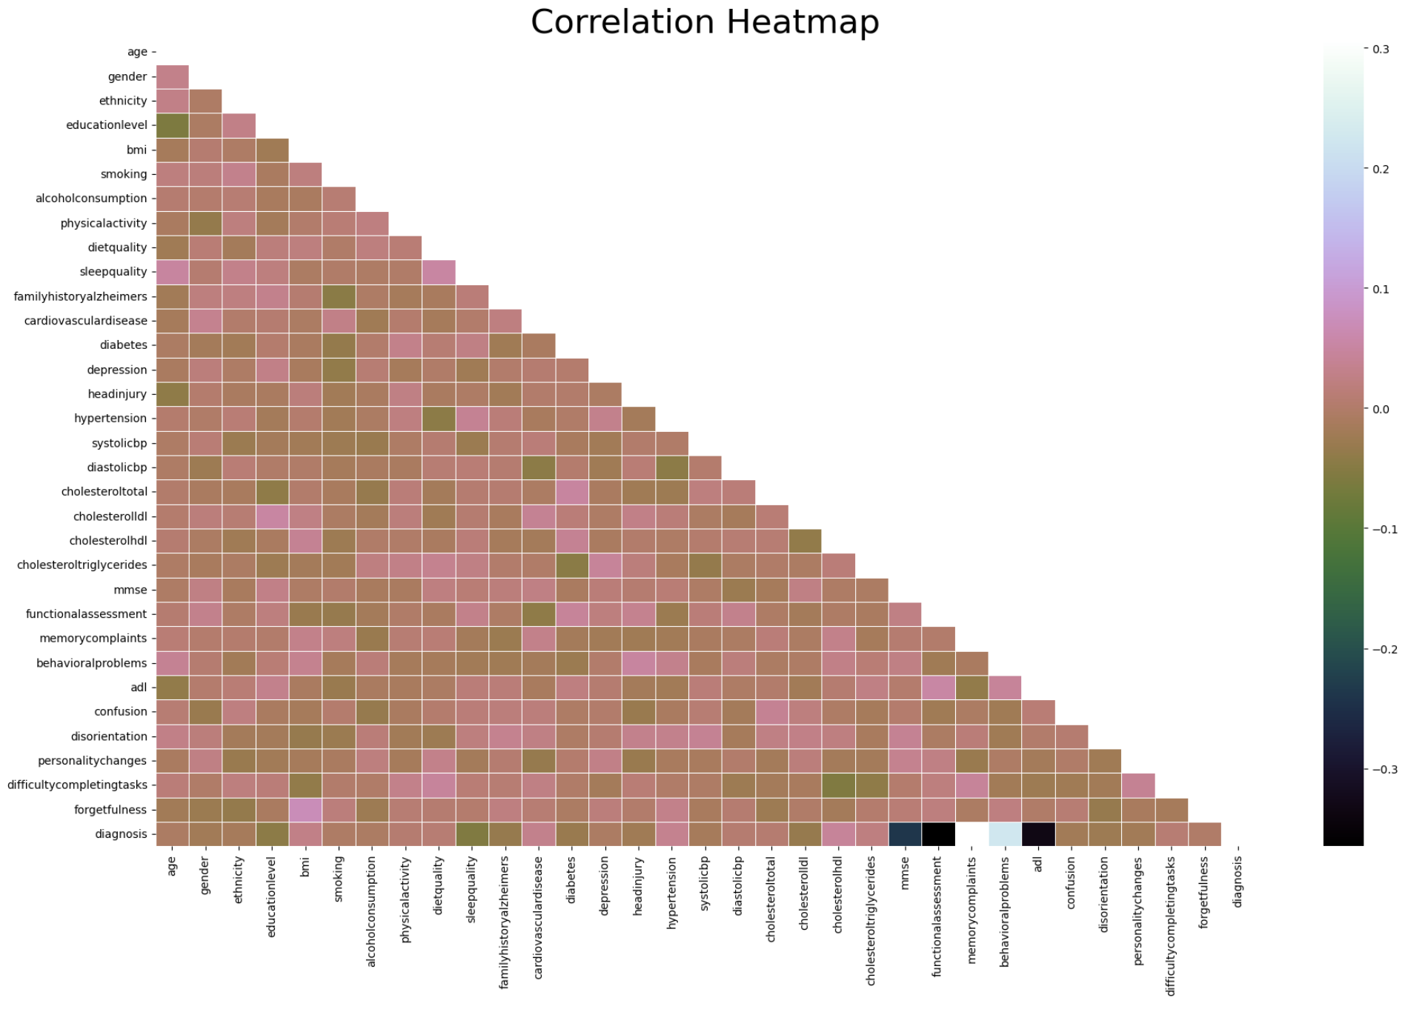
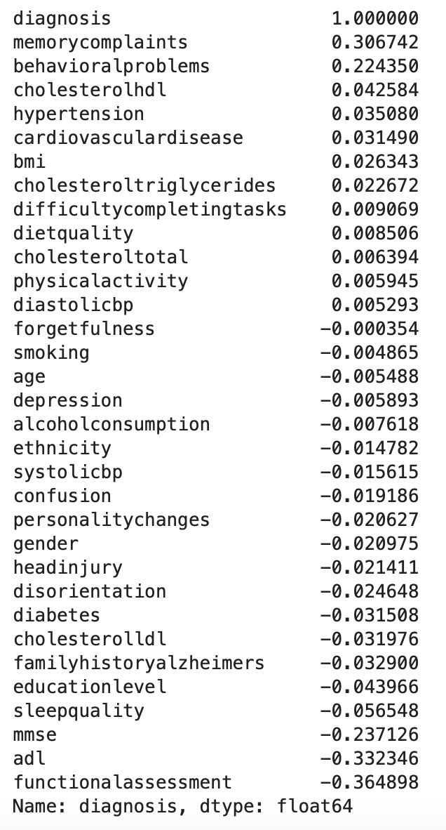

Slide 9
Correlation Analysis Summary
This shows the relationships between all independent variables and dependent variable (Diagnosis).
Strong Correlations:
Functional Assessment, ADL (Activities of Daily Living) and MMSE (Mini-Mental State Examination) are negatively correlated with the Diagnosis of Alzheimer's disease, with correlation coefficients of -0.36, -0.33, and -0.24 respectively.
This indicates that lower scores in these assessments are associated with a higher likelihood of an Alzheimer's diagnosis.
Behavioral Problems and Memory Complaints are positively correlated with the Diagnosis of Alzheimer's disease, with correlation coefficients of 0.22 and 0.30 respectively.
This means the presence of these issues is associated with a higher likelihood of an Alzheimer's diagnosis.
Weak Correlations:
Most lifestyle and health factors like BMI, Alcohol Consumption and Smoking exhibit weak correlations with Diagnosis.
Also, some medical history features like Hypertension and Diabetes show low correlation, suggesting less direct association.

Slide 10
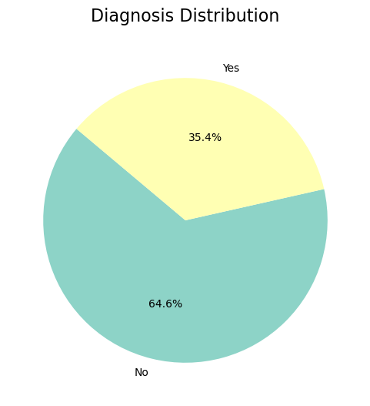
Target Variable Summary
760 out of 2,149, approximately 35.4% of the patients have been diagnosed with Alzheimer’s, while around 1,389 out of 2,149, representing 64.6% were not diagnosed.
“No Diagnosis” forms the majority, indicating that a larger proportion of the dataset does not have an Alzheimer’s disease diagnosis.
This confirms our previous observation in the Categorical Feature Distribution that the data is skewed heavily towards individuals without Alzheimer's Disease.

Slide 11
PREDICTIVE MODELING

Slide 12
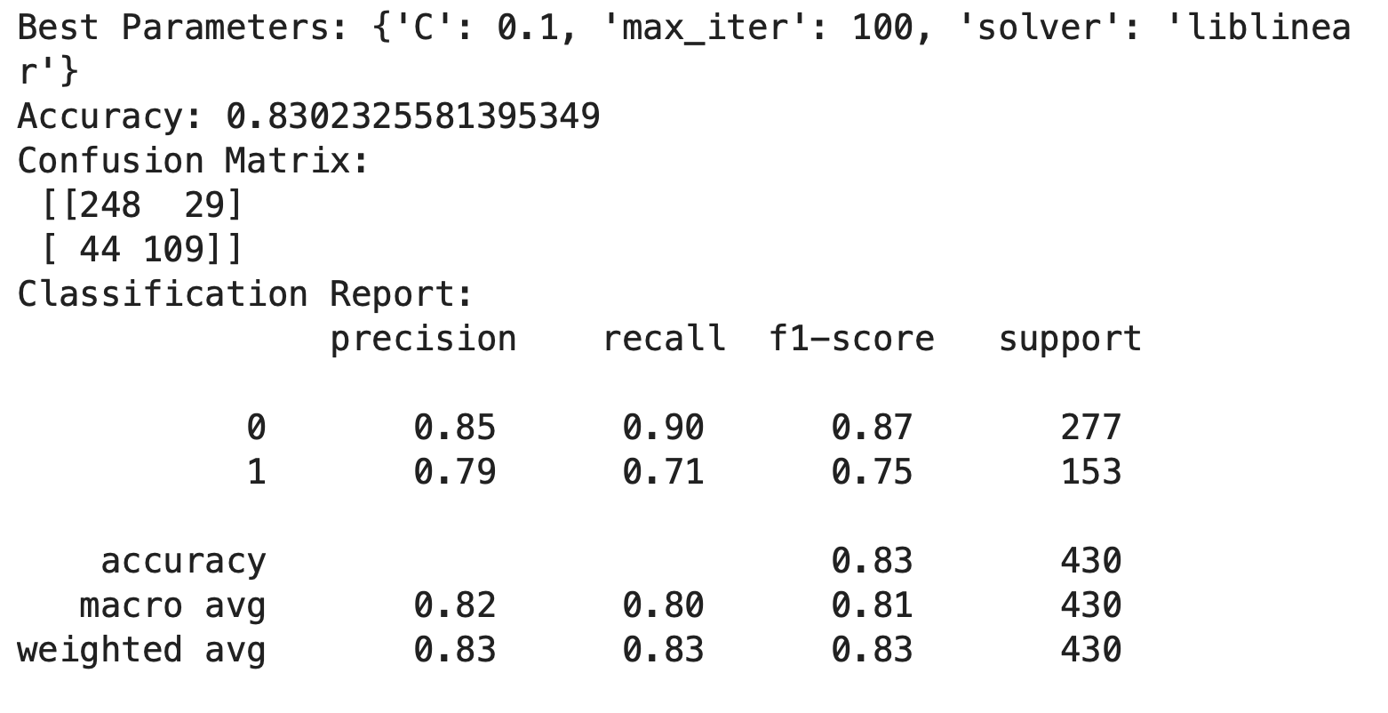
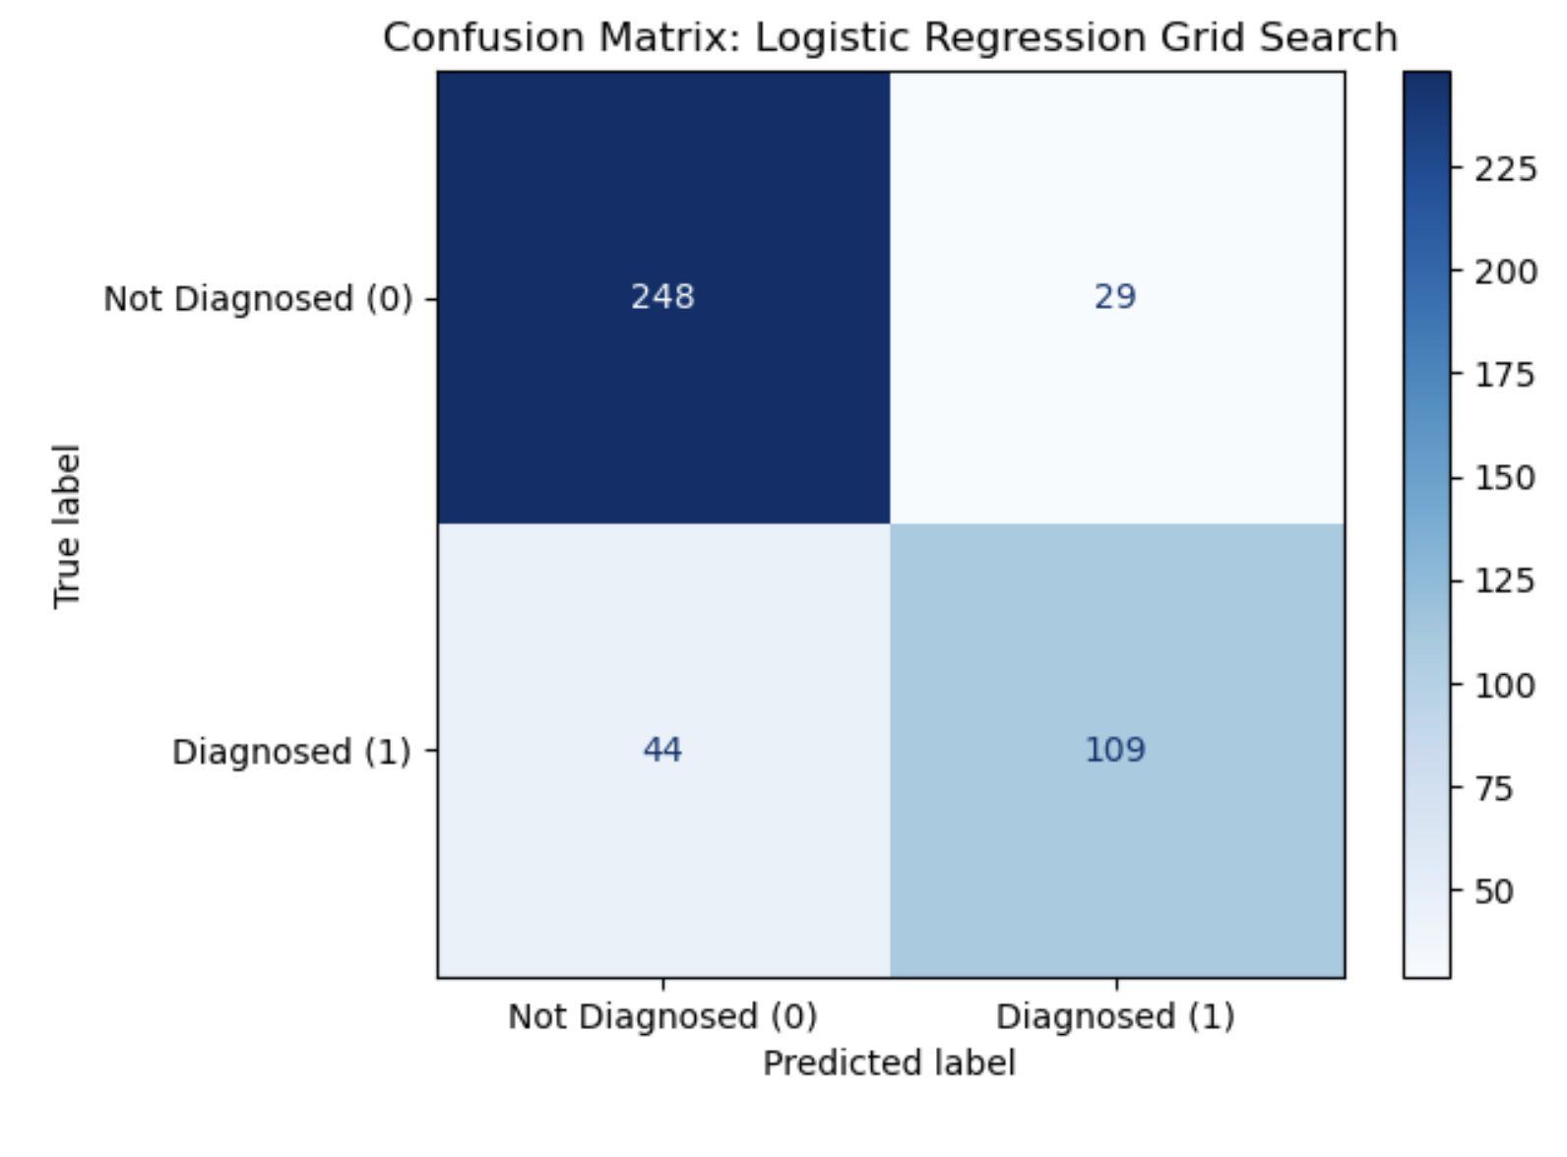
LOGISTIC REGRESSION grid search – REPORT & CONFUSION MATRIX

Slide 13
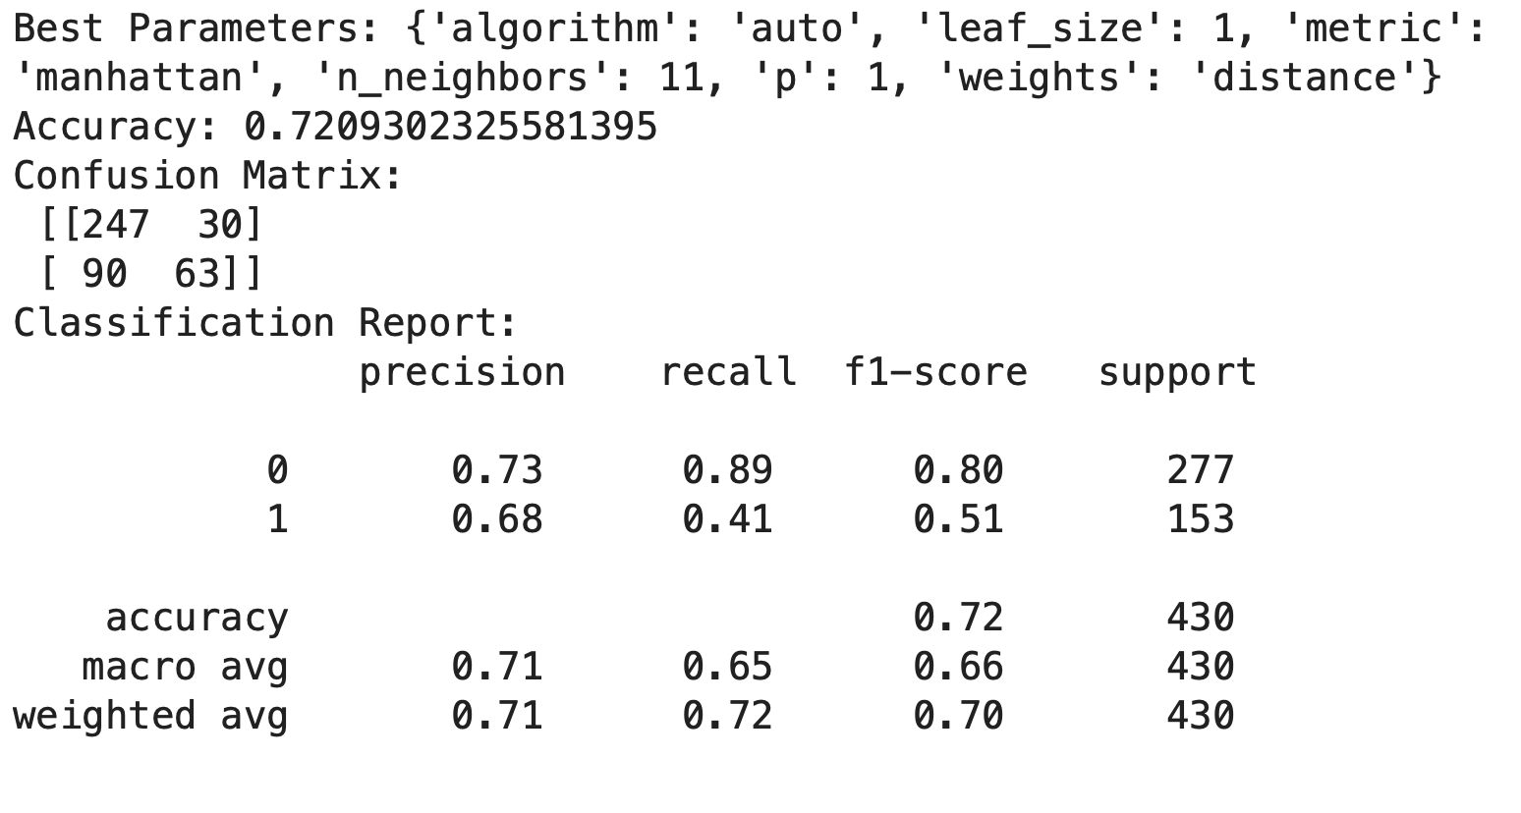
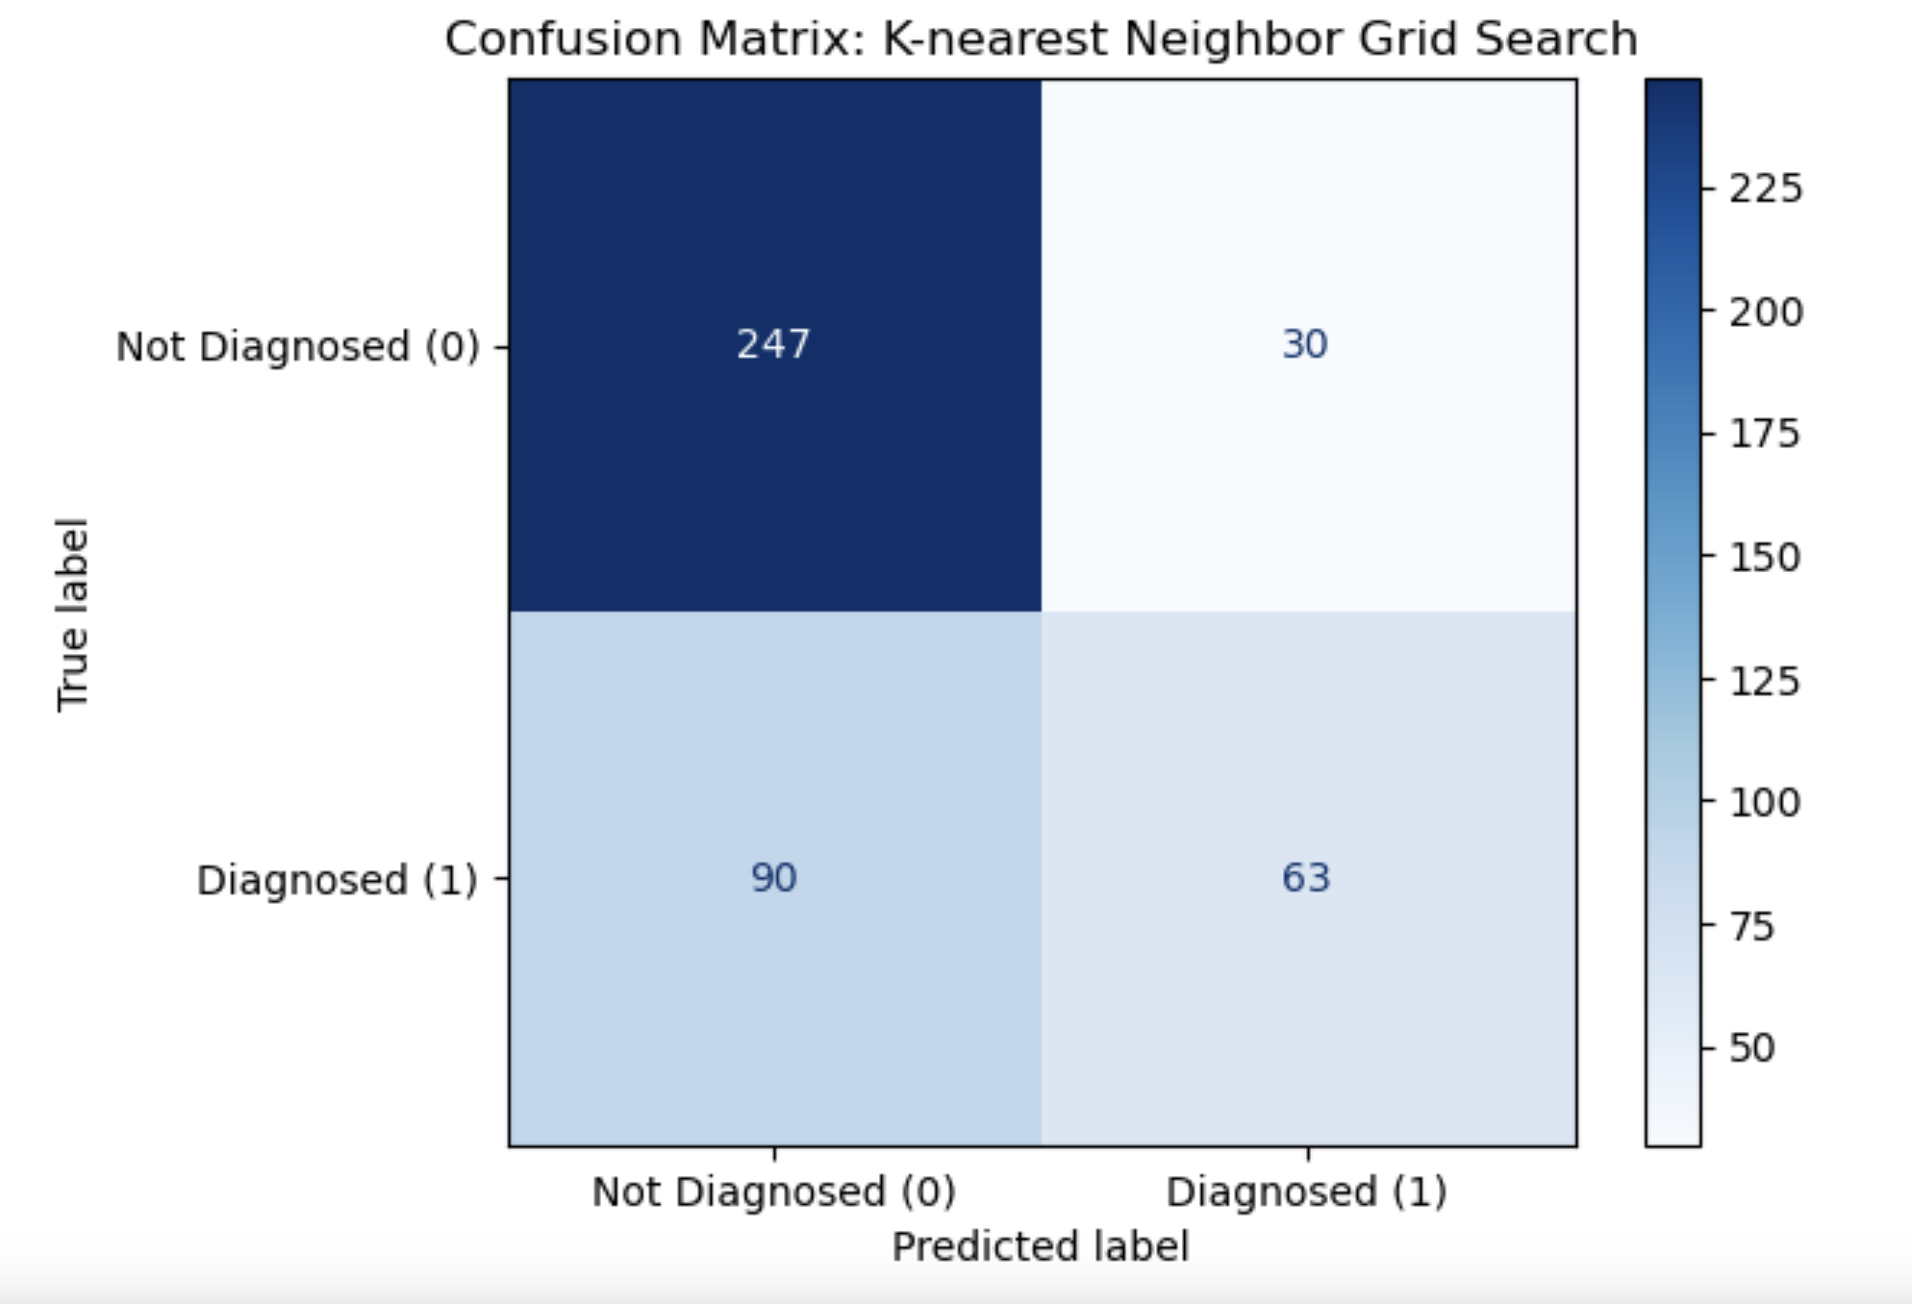
K-NEAREST NEIGHBOR GRID SEARCH – REPORT & CONFUSION MATRIX

Slide 14
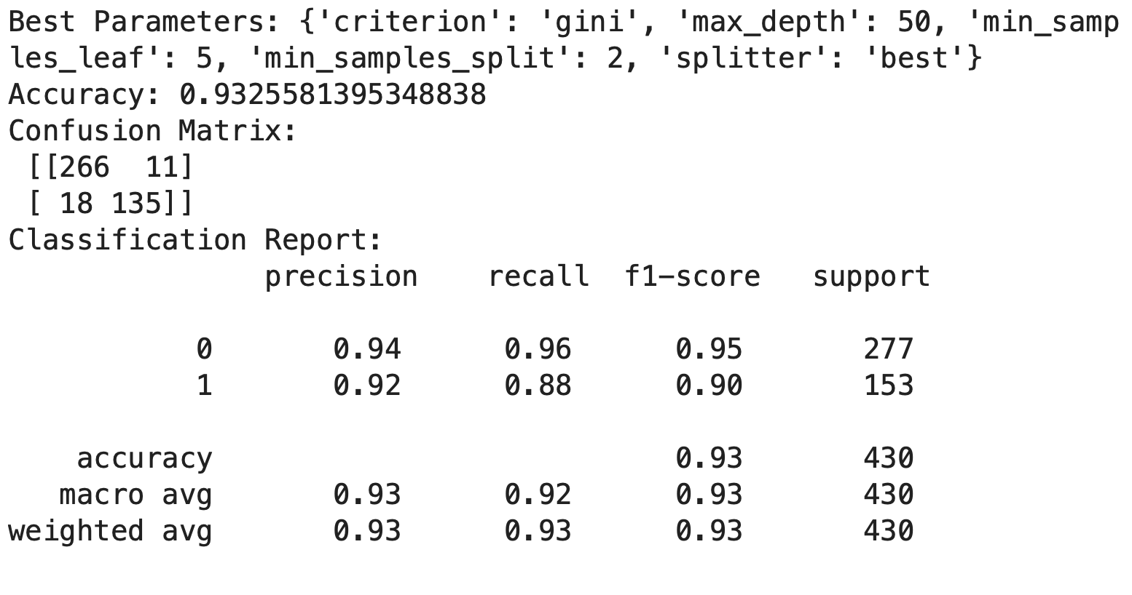
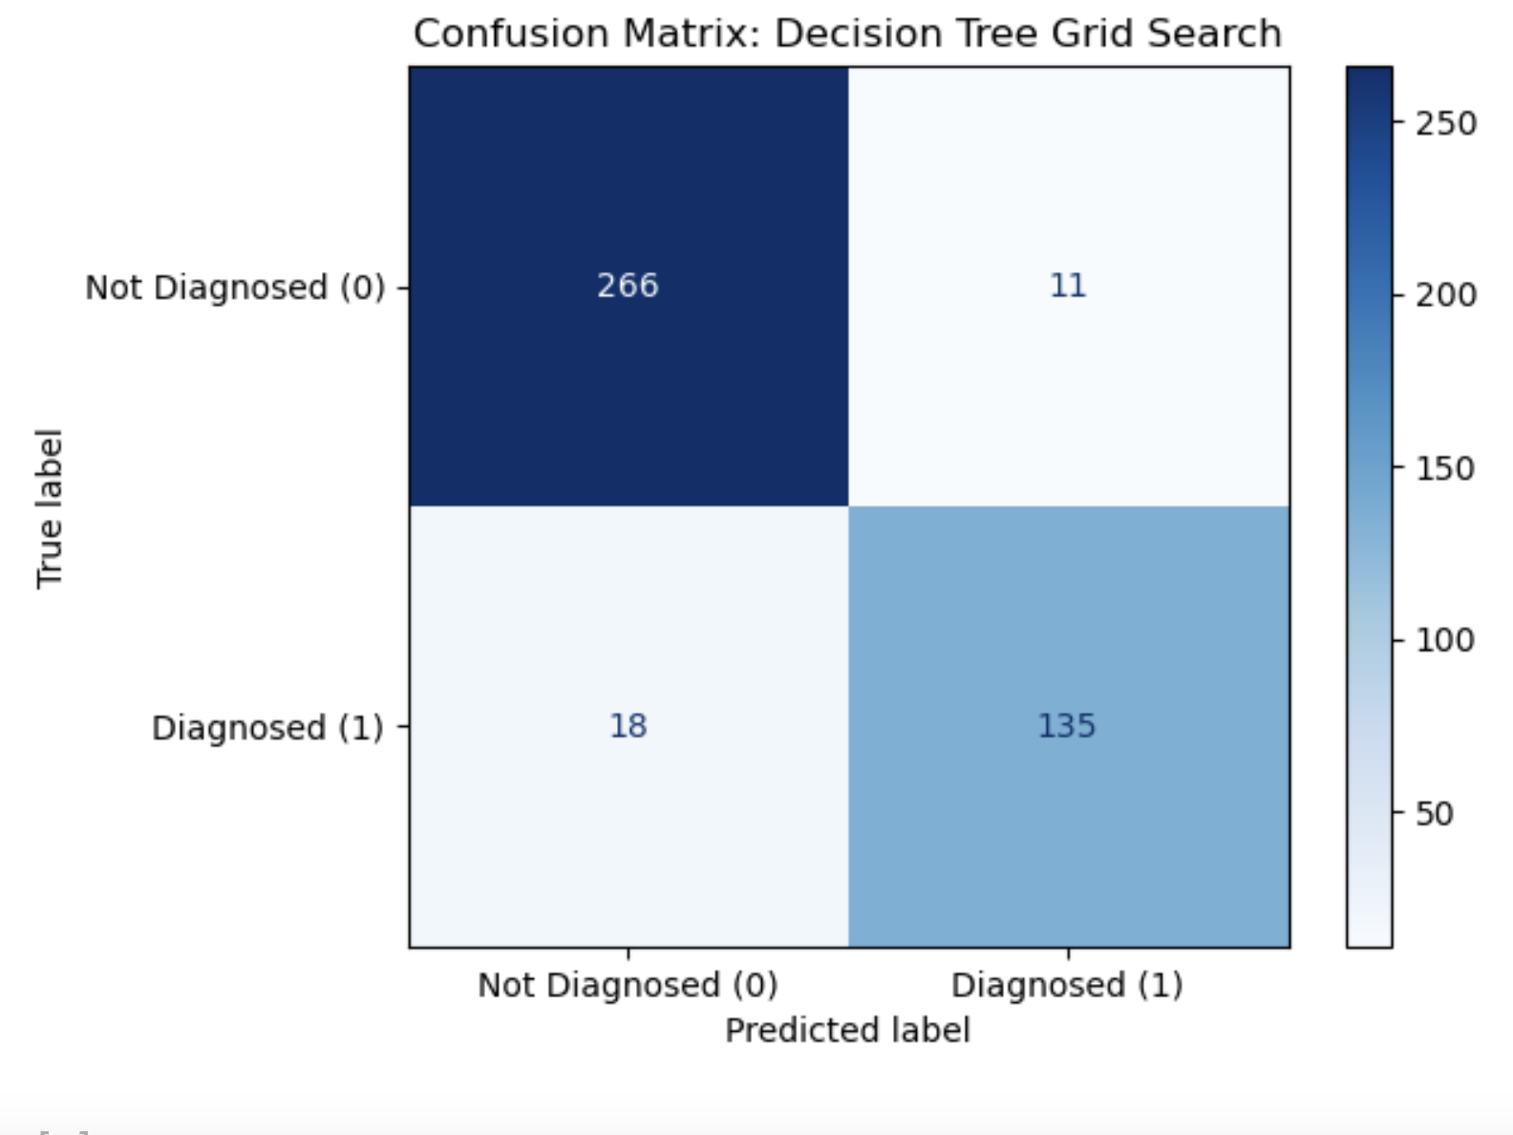
DECISION TREE GRID SEARCH – REPORT & CONFUSION MATRIX

Slide 15
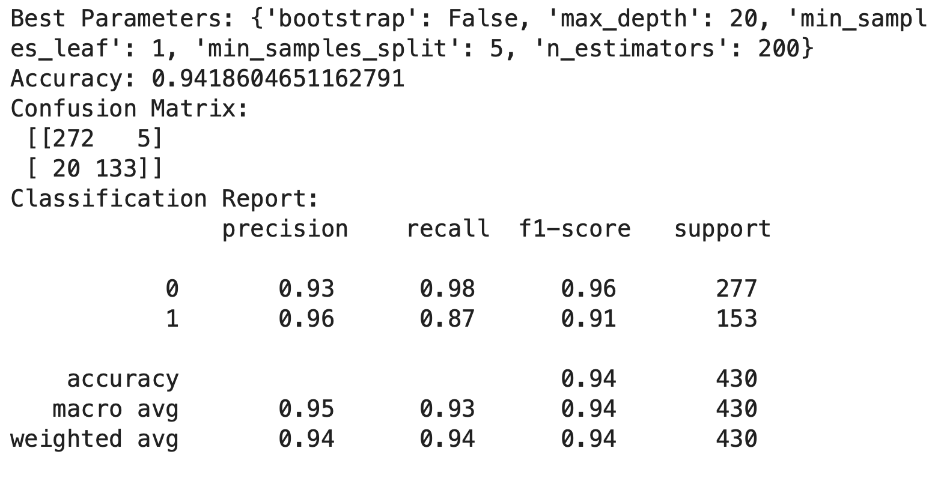
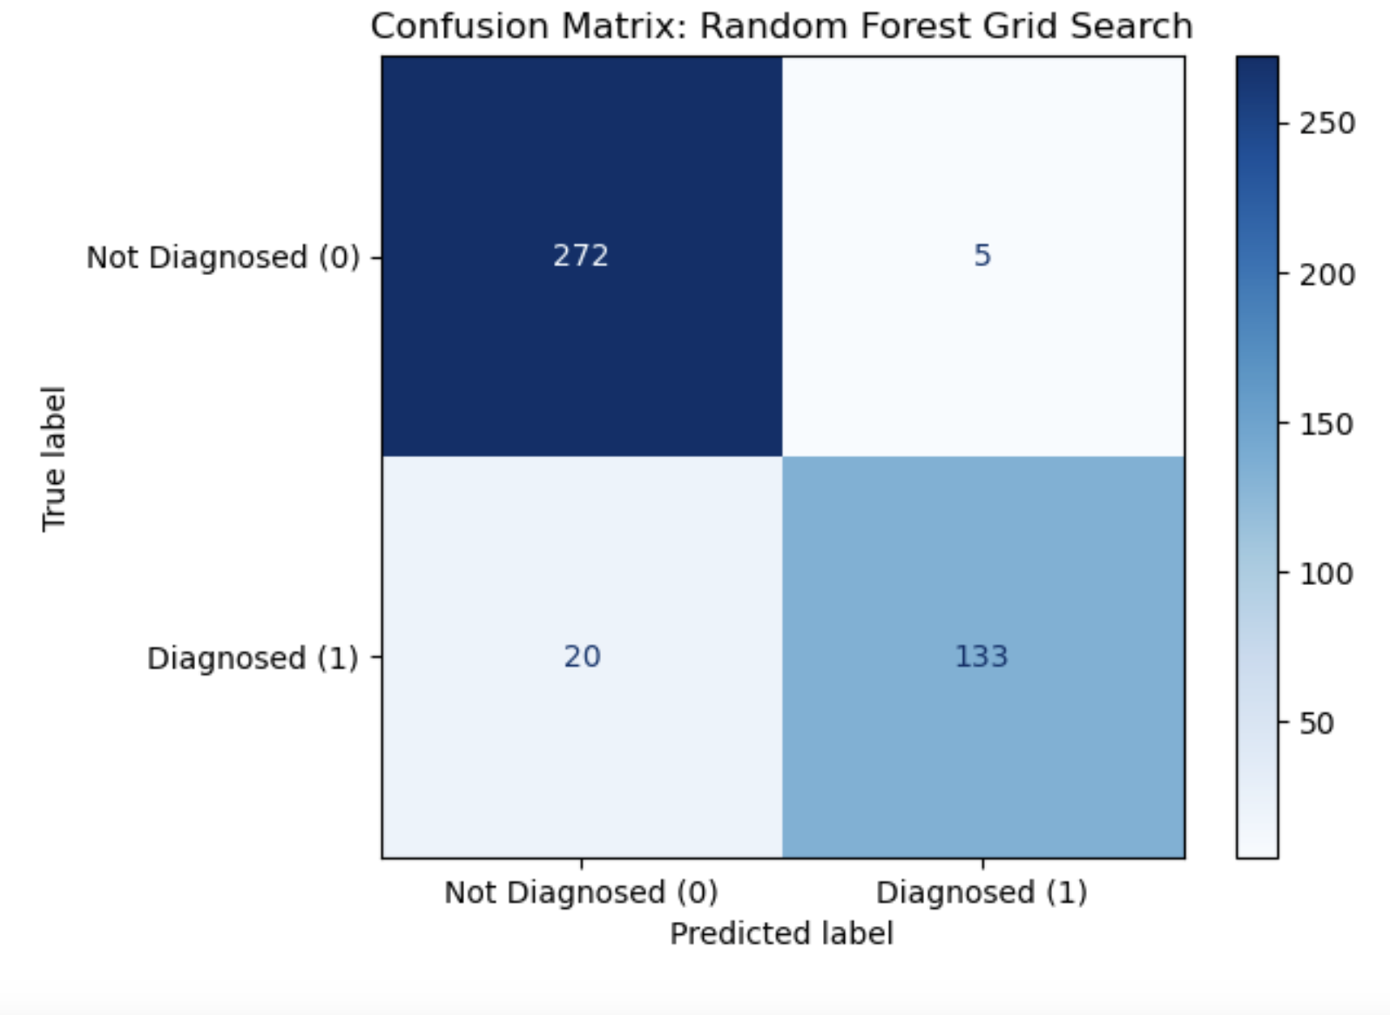
RANDOM FOREST GRID SEARCH – REPORT & CONFUSION MATRIX

Slide 16
RESULTS
Random Forest Grid Search performed the best in terms of the weighted average among the other models.
It has the highest of 94.18%

Slide 17
RECOMMENDATIONS
Memory Training Programs that reinforce recall through exercises, repetition, or visual aids.
Brain-Stimulating Activities
Crossword puzzles, reading, or learning new skills can support cognitive function.
Physical Exercise:
Regular exercise improves blood flow to the brain, reduces stress, and promotes physical health. Examples: Walking, yoga, or tai chi (especially for balance and relaxation).
Social Engagement:
Social activities like spending time with friends or participating in group programs can combat isolation and enhance mood.
Cholinesterase Inhibitors: These medications boost neurotransmitter levels to improve memory and thinking.

Slide 18
THANK YOU!
MEDAASE!

